Slide 1
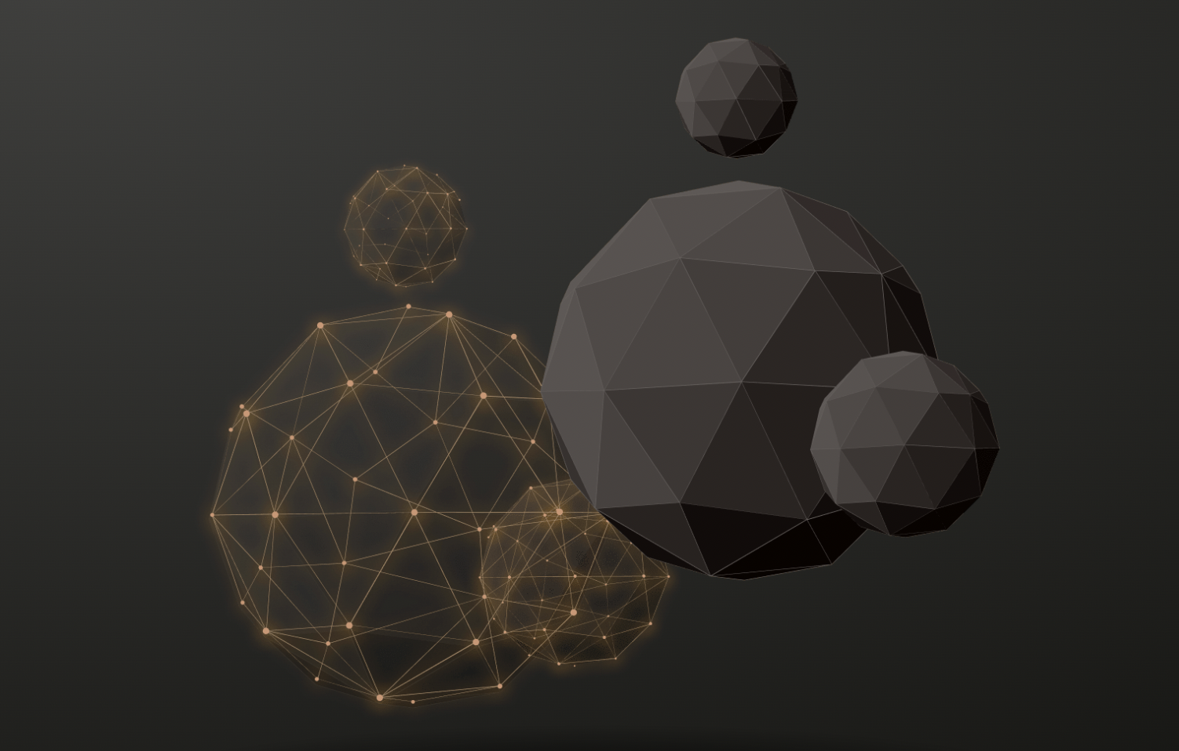
Final Briefing of Group 3 20230608
111.2_人工智慧 邱垂昱 教授 Artificial Intelligence
Using Core competencies of ChatGPT to help quickly understand articles
ChatGPT
ChatPDF
ChatDOC

Slide 2
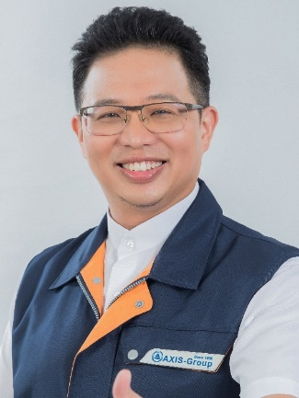
Team Members
Team member List
陳俊華 Kirin Chen | 何哲平 Ace Ho
工管博二 | 創新碩一
110749018

Slide 3
Index of Briefing
Index of Briefing： 1. Three ways to use ChatGPT
2. Practical instructions
3. Advantages and disadvantages
4. Conclusions

Slide 4


